Slide 1
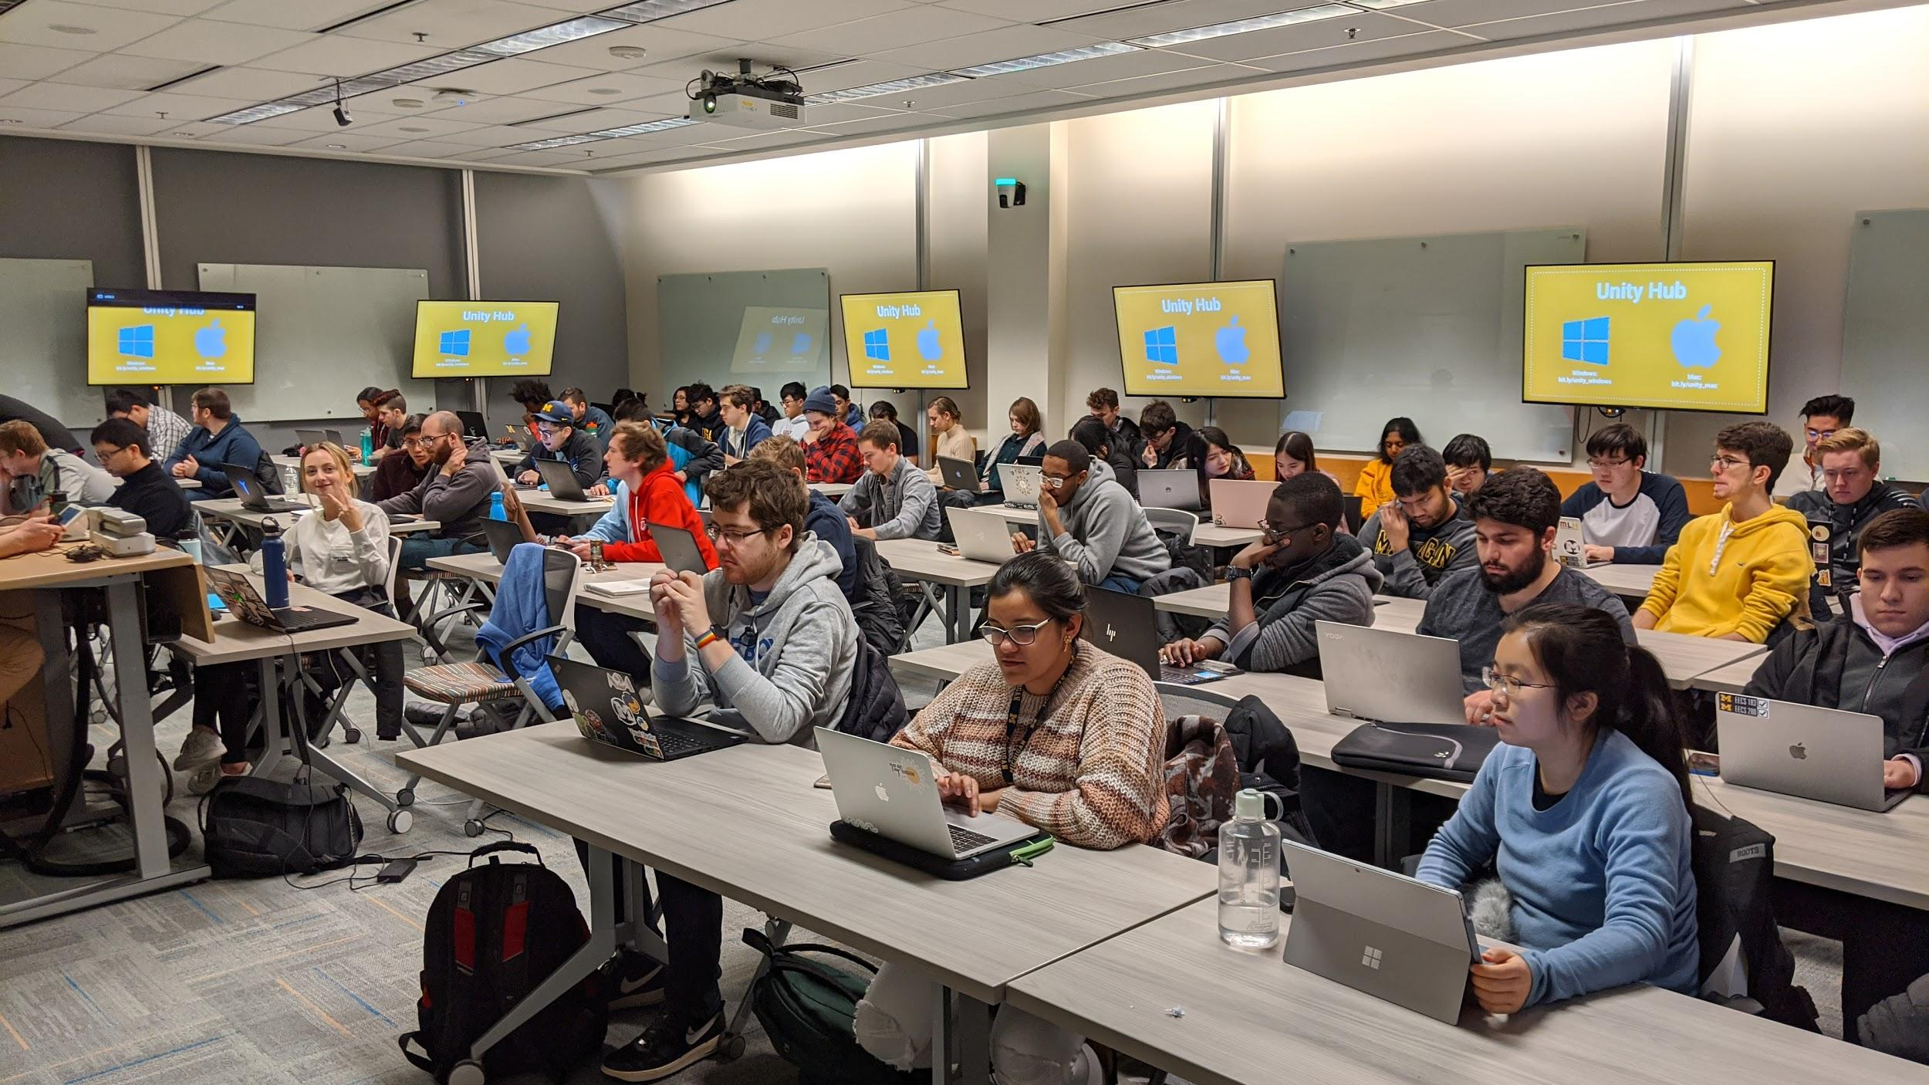
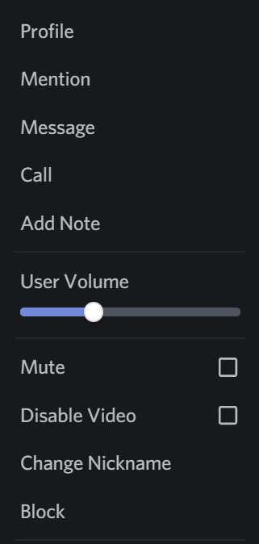


WolverineSoft Studio
Mid Pre-Alpha II
Dislike the music?
Right-click on Groovy in the Voice Chat list, and either turn down his volume or mute him entirely!
Now Playing: Various Video Game OSTs
02.28.2021

Slide 2
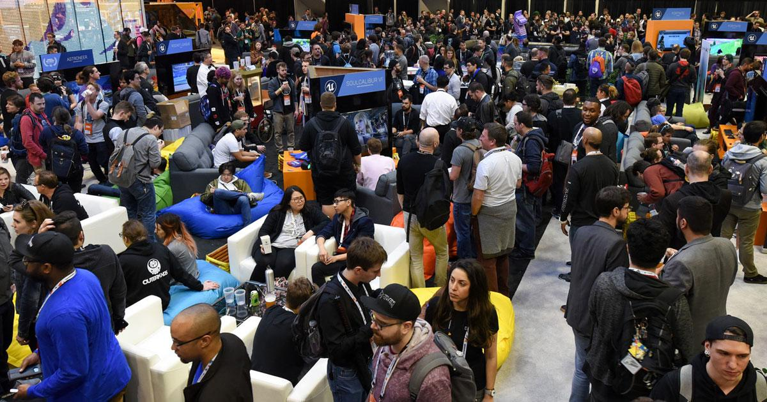



AGENDA
State of the Game
Announcements
Showcases
Final Thoughts
Pod & Department Meetings

Slide 3

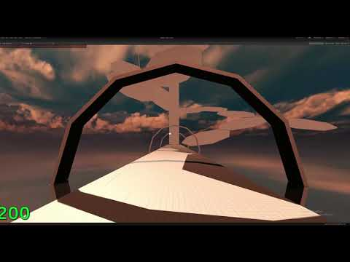
STATE OF THE GAME

Slide 4
AGENDA
State of the Game
Announcements
Showcases
Final Thoughts
Pod & Department Meetings

Slide 5
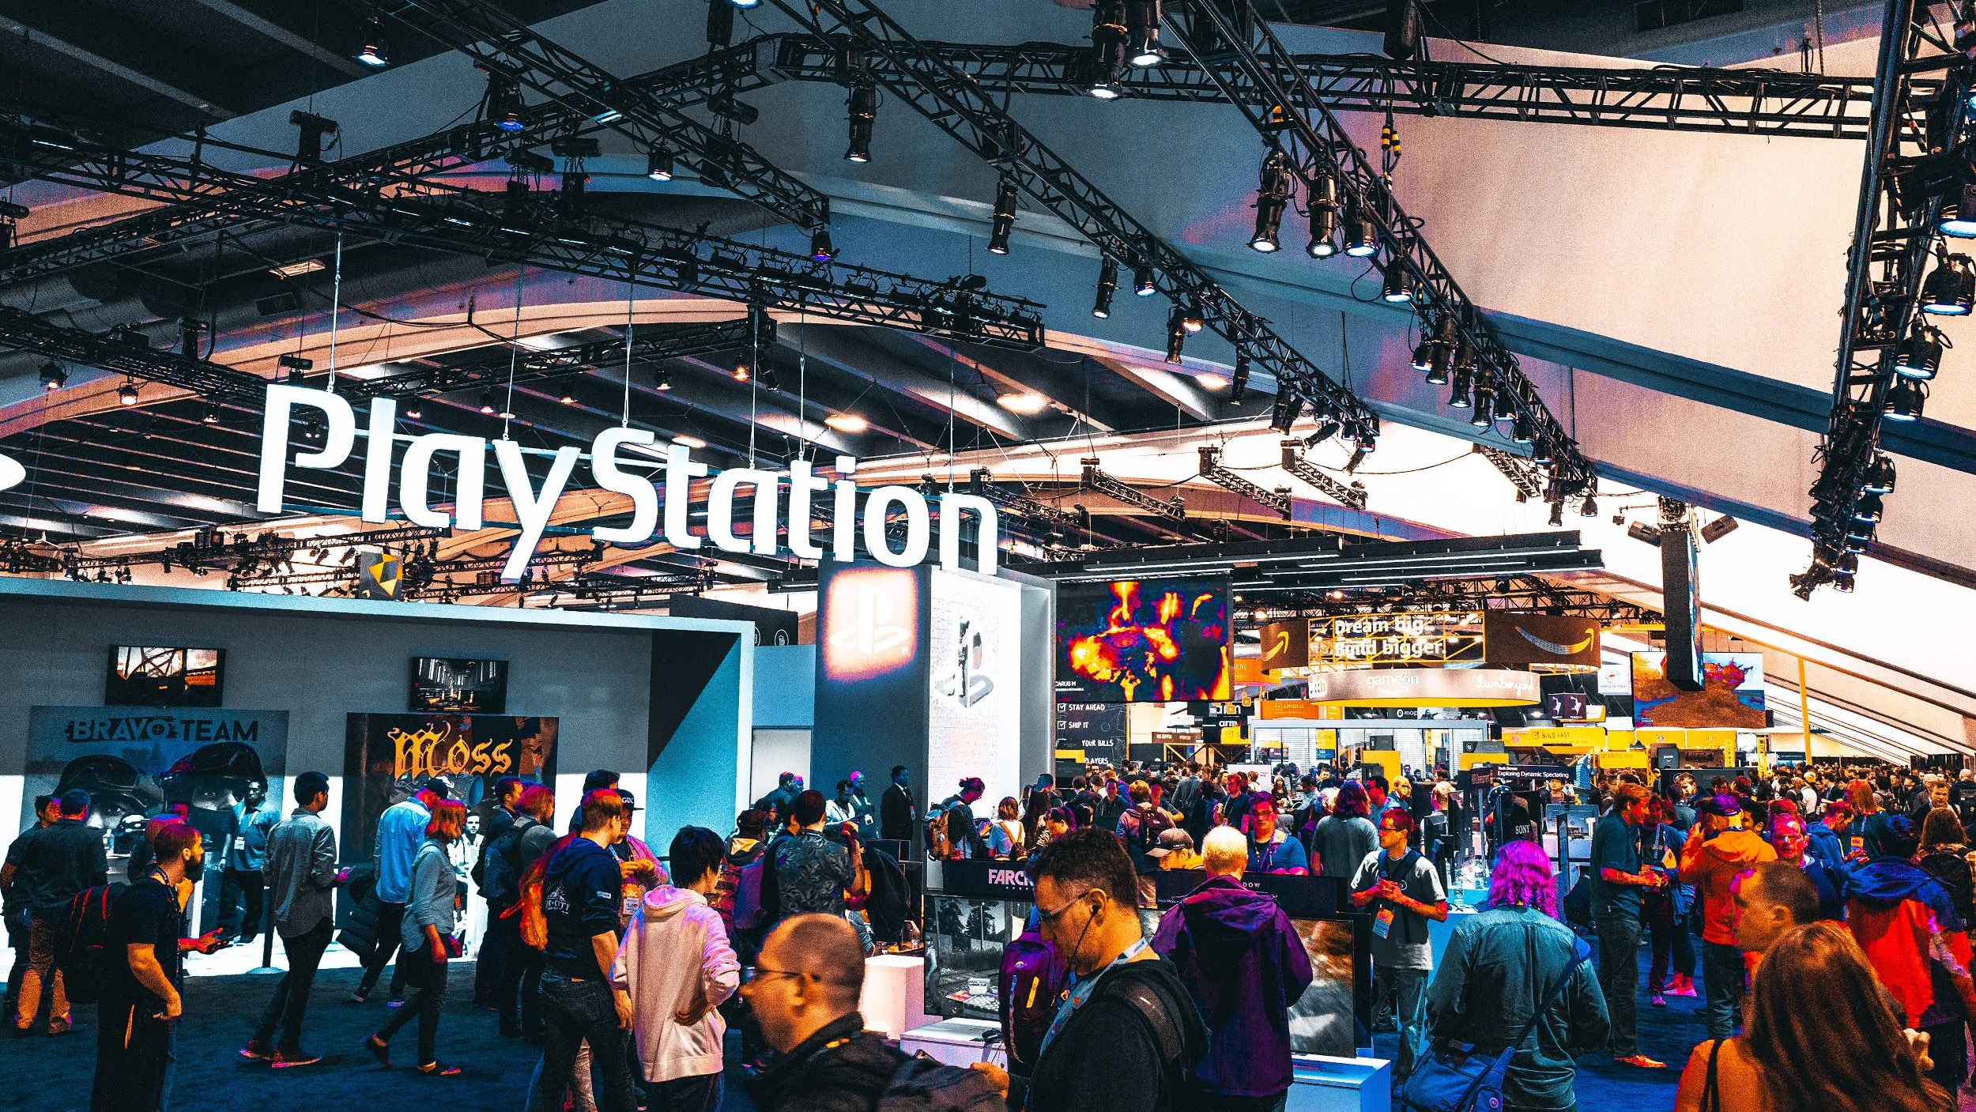

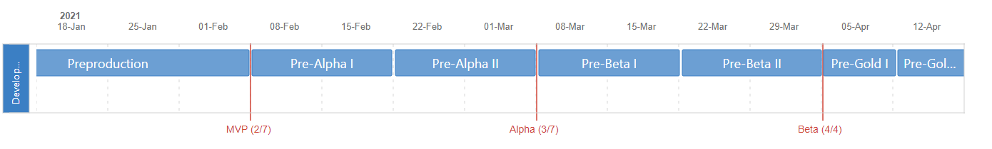
ANNOUNCEMENTS
Timeline Reminder
This coming week will be our final week of the Pre-Alpha II sprint. This is our second week of production!
By the end of our Alpha phase, some representation of every feature in the game should be in our builds. Alpha means feature-lock, and will end on 3/7! Our absolute top priority is closing our game loop.

Slide 6
ANNOUNCEMENTS
We Hear You
Tremendous thank you to everybody for the feedback you provided during our brief 4-Ls retrospective at the end of last week’s meeting! We’ll aim to do this at the end of every sprint.
The leads reviewed your feedback at our meeting yesterday and we’ll be making changes accordingly. Thanks for your patience and all your effort!

Slide 7
ANNOUNCEMENTS
Give more feedback!
From now on, look to give feedback to other members 2-3 times a week. You can find other assets in the #-preview channels. Go outside your comfort zone and give feedback to other departments!
MDP students, giving feedback can count towards your weekly hours commitment.
We won’t be enforcing the 2-3 times a week rule, but we greatly appreciate those who give others feedback - never be intimidated to do so, an outside perspective is the best way we can learn!

Slide 8
ANNOUNCEMENTS
Group Work Hours
This week on Monday, Wednesday, and Friday, we’ll have group work hours from 8 - 10 PM ET in the Working VC.
Updated on Google Calendar!
Completely optional, and you’re free to sit in and stay muted/deafened or even do non-studio work during this time. The goal is to boost productivity, and give a space where you can reach other members of the studio.
MDP students - if you intend any of these sessions, remember to log it in your dev blogs!

Slide 9
ANNOUNCEMENTS
Questions on Tasks?
We noticed that some Jira tasks lack descriptions and/or examples. In the future, we’ll be much more cognizant about including those.
In the meantime, here are some things that should help:
Read our sprint roadmaps! They are in the Confluence under Departments > Design > _Game Design Document > Roadmaps and contain additional information on most tasks
Search through our Confluence documents and #design-preview! Nearly everything in the game is documented in great detail - it can just be a matter of finding that documentation.
Ask our Designers! They’re always down to help :-)

Slide 10
AGENDA
State of the Game
Announcements
Showcases
Final Thoughts
Pod & Department Meetings

Slide 11

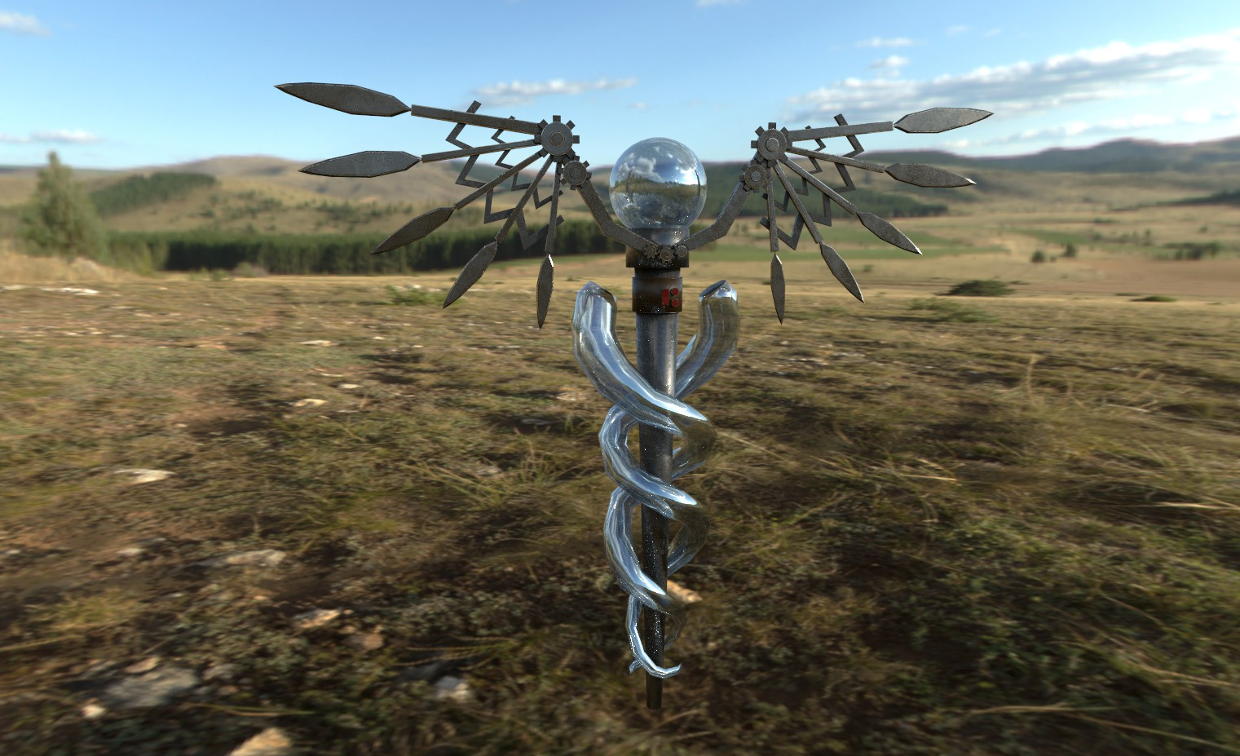
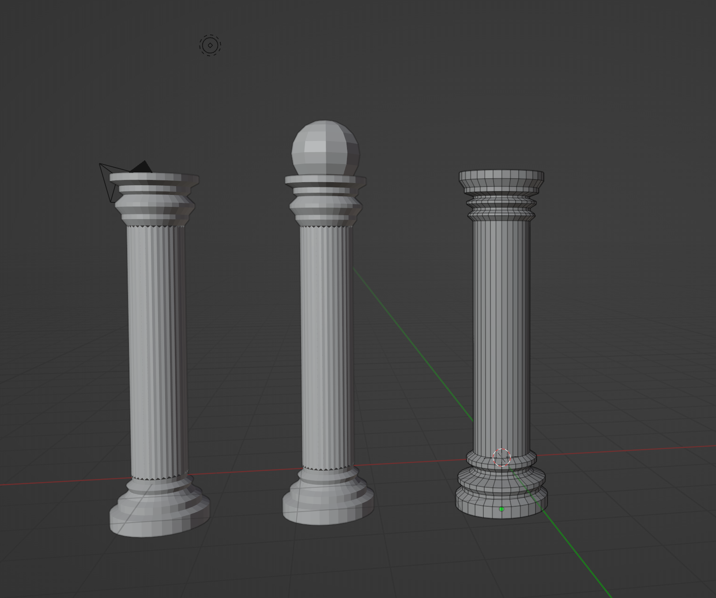
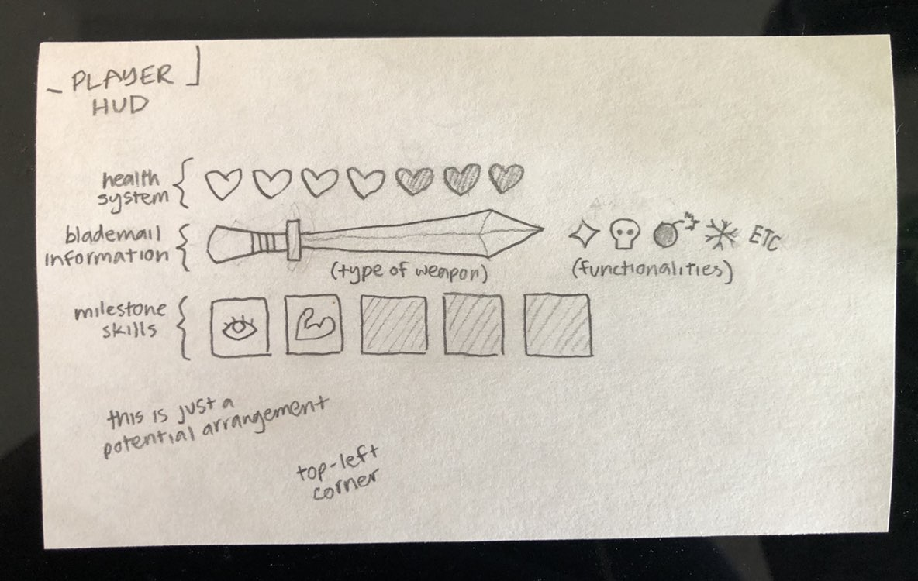
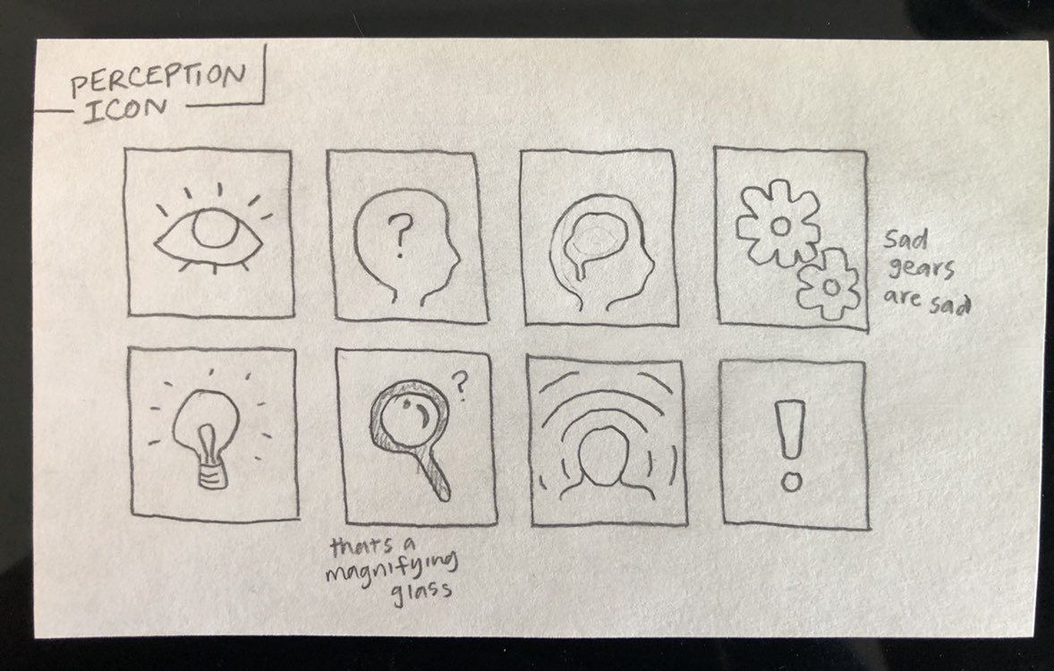
Art Department
Player HUD Concepts by Kaavya Ramachandhran
Caduceus Model by Lucy Zhang
Pillar Models by Lakyla Thomas

Slide 12

Audio Department
Main Menu v2 by Shreya Patibanda
Open & Close Shop SFX by Emily Sulkey
Air Glide SFX by Logan Hughes

Slide 13
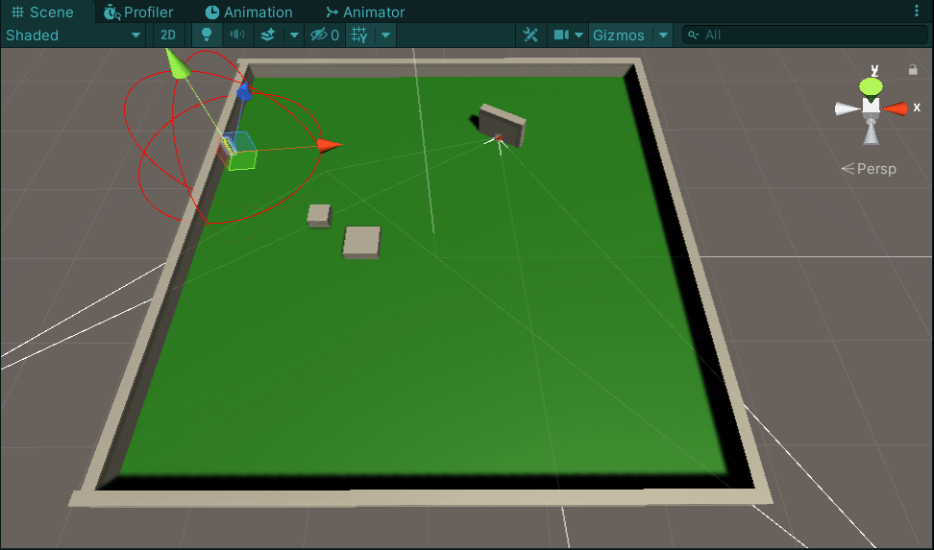
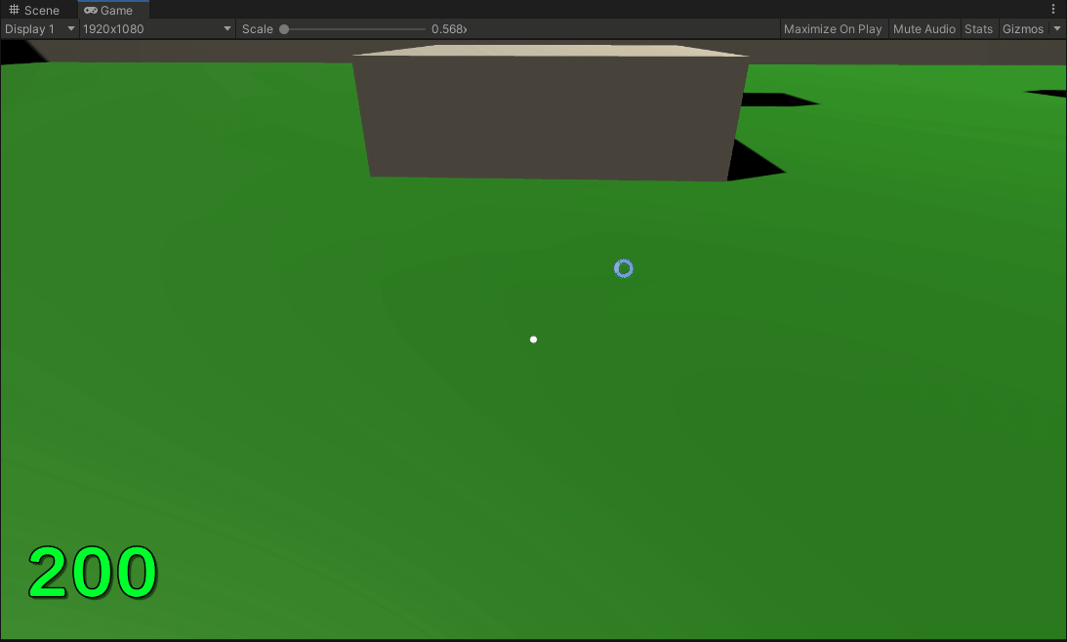
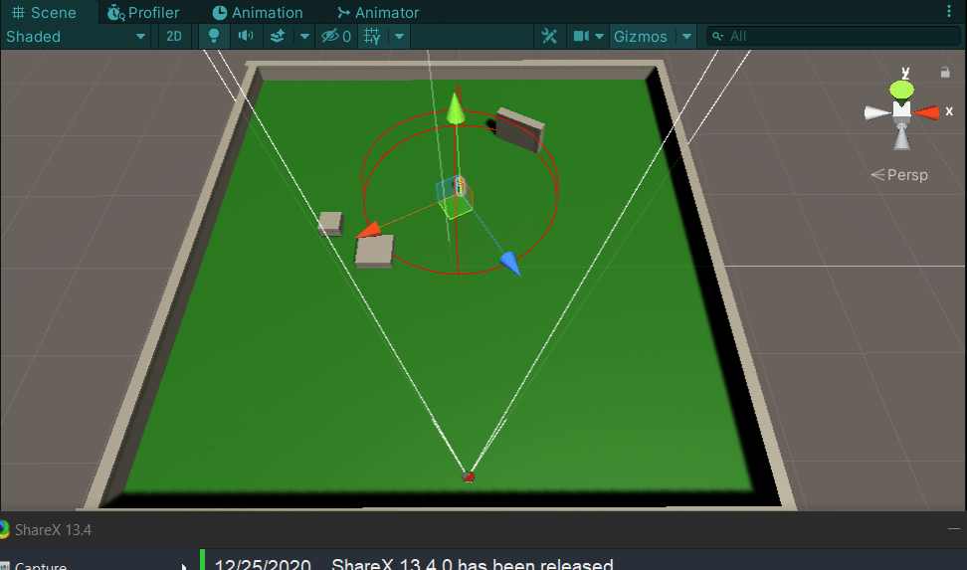
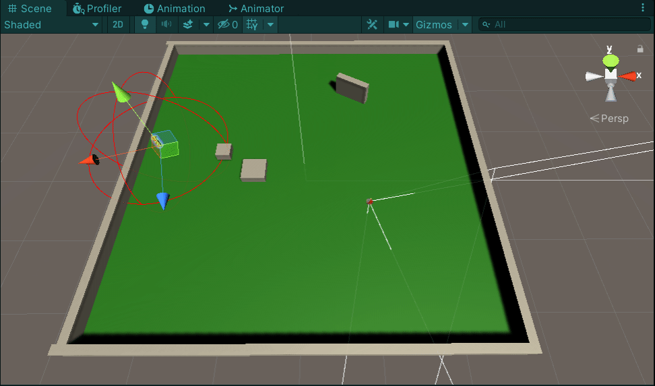
Programming Department
Enemy Patrol AI by Nick Cotton
Double Jump by Steven Tam

Slide 14
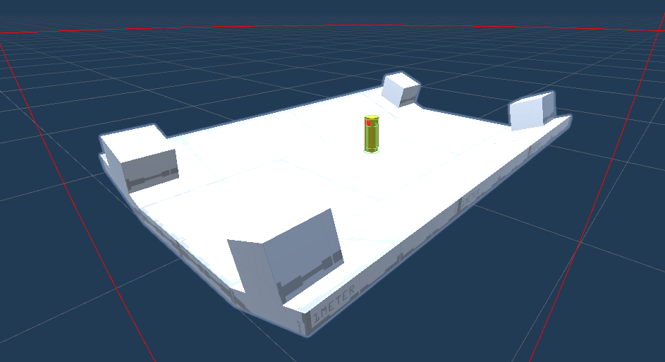
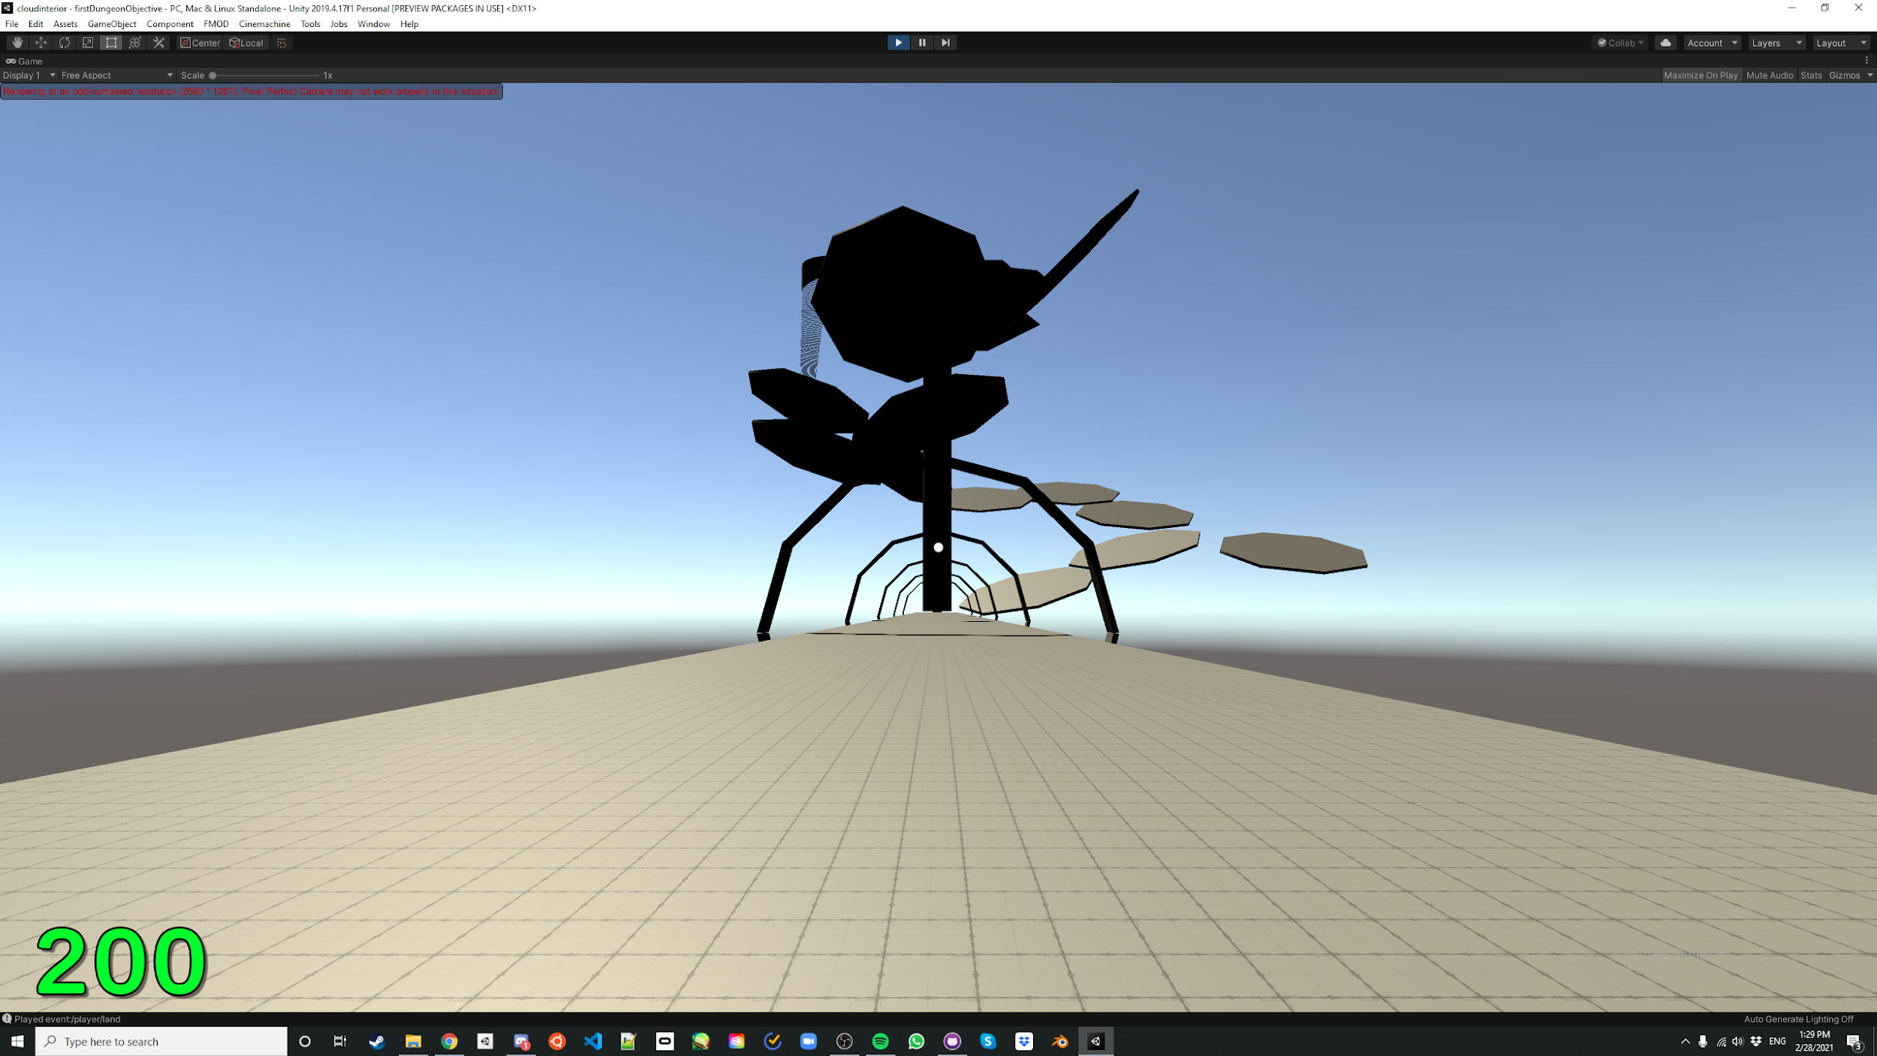
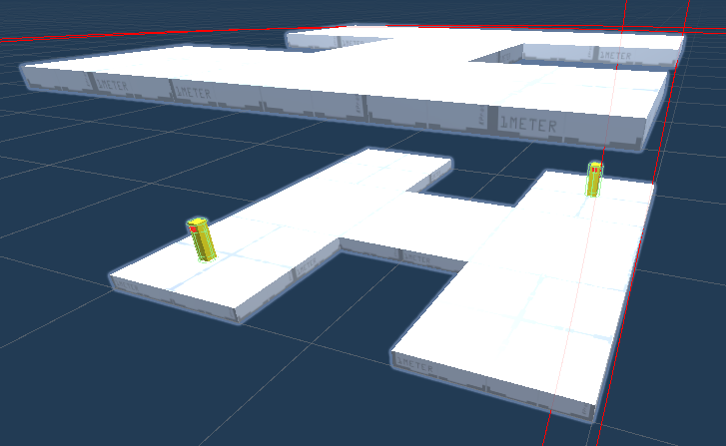
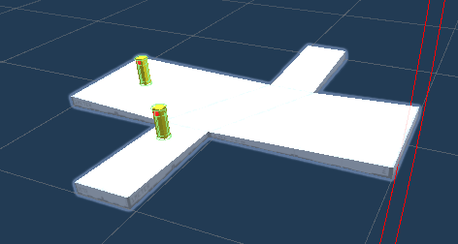
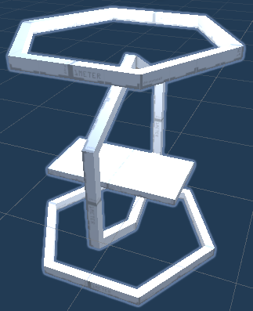
Design Department
Dungeon Room Reworks by Manuel Guzman
First Dungeon Objective by Paul Young

Slide 15

...This really doesn’t begin to cover the progress made!
Participate in the preview channels! Your feedback is appreciated!

Slide 16
AGENDA
State of the Game
Announcements
Showcases
Final Thoughts
Pod & Department Meetings

Slide 17
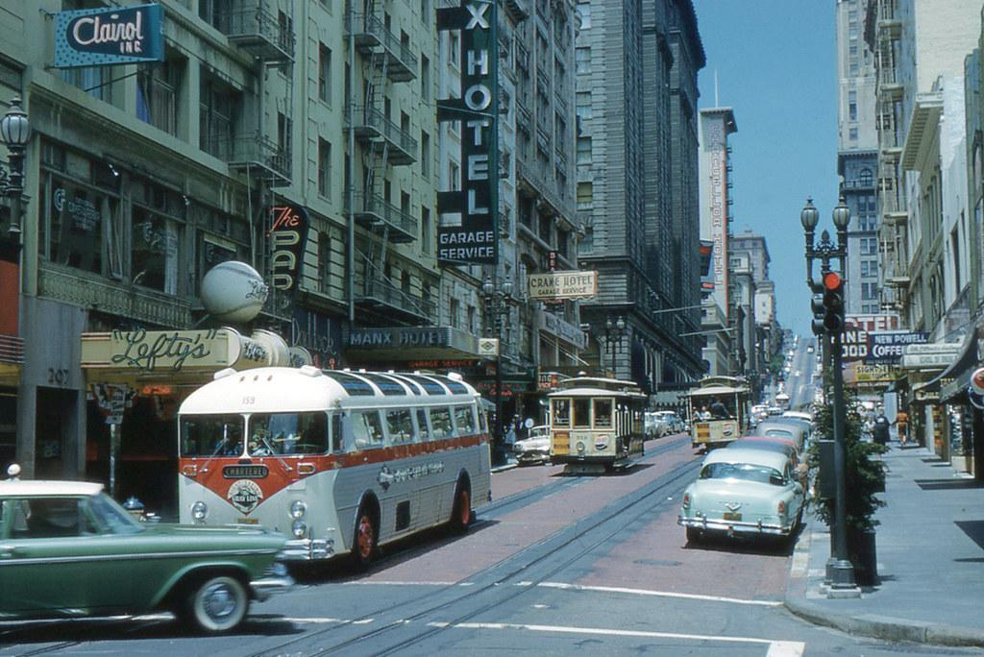

Reminders
Our next meeting will take place next Sunday, March 7th!
Don’t forget about all our optional group working hours this week on Monday, Wednesday, and Friday from 8-10 PM ET!
Post your work and progress in the #-preview channels, we love to see it!
Message me on Discord any time if you have any general Studio questions!

Slide 18
AGENDA
State of the Game
Announcements
Showcases
Final Thoughts
Pod & Department Meetings

